Slide 1
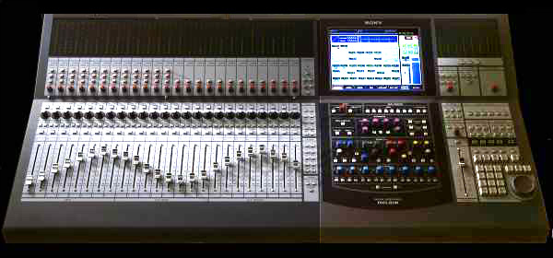
Constant Source Node

Slide 2
Controlling multiple parameters with constantSourceNode
constantSourceNode is the simplest audio node
generates single channel with constant output
One parameter, offset, with default value 1
What is it good for?
Connect constant source and another node to a gain node → acts like an adder
Set parameter values for many nodes with one ConstantSource
Notes:
It represents an audio source whose output is a constant value. It is useful as a constant source in general, and can be used as if it were a constructible AudioParam by automating its offset or connecting another node to it.
It is an audioScheduledSourceNode, meaning that its start() method must be called in order for it to output nonzero values.
The single output of this node consists of one channel (mono).
The ConstantSourceNode has a single a-rate parameter, offset, with default value of 1. It specifies the constant value of the source.
This simple node is actually one with a lot of uses. By having it as one of two or more inputs to a gain node, it acts like an adder, adding the offset to the input. By having it as input to the gain parameter of a gain node, it acts like a multiplier, multiplying the input by the offset. And as we shall see, it can be used to set parameter values for many nodes with one ConstantSource.

Slide 3
Controlling multiple parameters with constantSourceNode
constantSourceNode is the simplest audio node
generates single channel with constant output
One parameter, offset, with default value 1
What is it good for?
Connect constant source and another node to a gain node → acts like an adder
Set parameter values for many nodes with one ConstantSource
Notes:
It represents an audio source whose output is a constant value. It is useful as a constant source in general, and can be used as if it were a constructible AudioParam by automating its offset or connecting another node to it.
It is an audioScheduledSourceNode, meaning that its start() method must be called in order for it to output nonzero values.
The single output of this node consists of one channel (mono).
The ConstantSourceNode has a single a-rate parameter, offset, with default value of 1. It specifies the constant value of the source.
This simple node is actually one with a lot of uses. By having it as one of two or more inputs to a gain node, it acts like an adder, adding the offset to the input. By having it as input to the gain parameter of a gain node, it acts like a multiplier, multiplying the input by the offset. And as we shall see, it can be used to set parameter values for many nodes with one ConstantSource.

Slide 4

Controlling multiple parameters with constantSourceNode
Load multitrack music and use the constant source node to control the level of several tracks simultaneously
Congas
Here, could just connect/disconnect sources to single gain node
But constant source could control other parameters on other nodes
Can use it for grouping as a mixing task
Bass
Destination
Ukelele DI
Ukelele mic
Viola
Constant Source
Notes:
It represents an audio source whose output is a constant value. It is useful as a constant source in general, and can be used as if it were a constructible AudioParam by automating its offset or connecting another node to it.
It is an audioScheduledSourceNode, meaning that its start() method must be called in order for it to output nonzero values.
The single output of this node consists of one channel (mono).
The ConstantSourceNode has a single a-rate parameter, offset, with default value of 1. It specifies the constant value of the source.
This simple node is actually one with a lot of uses. By having it as one of two or more inputs to a gain node, it acts like an adder, adding the offset to the input. By having it as input to the gain parameter of a gain node, it acts like a multiplier, multiplying the input by the offset. And as we shall see, it can be used to set parameter values for many nodes with one ConstantSource.

